Slide 1
Digital Portfolio
DIGITAL PORTFOLIO
STUDENT NAME: RAKSHANA M REGISTER NO & NMID: ASUNM112401111058242 DEPARTMENT: BSC COMPUTER SCIENCE COLLEGE: LNG GOVERNMENT COLLEGE UNIVERSITY: MADRAS UNIVERSITY
STUDENT NAME: RAKSHANA M REGISTER NO & NMID: ASUNM112401111058242 DEPARTMENT: BSC COMPUTER SCIENCE COLLEGE: LNG GOVERNMENT COLLEGE / MADRAS UNIVERSITY
Rakshana M
asunm1124
STUDENT NAME: RAKSHANA M
REGISTER NO & NMID: ASUNM112401111058242
DEPARTMENT: BSC COMPUTER SCIENCE
COLLEGE: LNG GOVERNMENT COLLEGE
UNIVERSITY: MADRAS UNIVERSITY

Slide 2
PROJECT TITLE
DIGITAL PORTFOLIO
DIGITAL PORTFOLIO
Digital Portfolio

Slide 3


AGENDA
Problem Statement
Project Overview
End Users
Tools and Technologies
Portfolio design and Layout
Features and Functionality
Results and Screenshots
Conclusion
Github Link
3/21/2024 Annual Review

Slide 4

PROBLEM STATEMENT
Many students struggle to showcase their skills Traditional resumes do not show practical work Employers cannot evaluate projects easily Need a professional digital portfolio Bridges the gap between skills and presentation Helps students stand out to recruiters

Slide 5

PROJECT OVERVIEW
Digital portfolio website for students Showcases personal details, skills, and projects Accessible on desktop and mobile Interactive and professional design Easy to update with new projects Improves visibility for recruiters and mentors

Slide 6

WHO ARE THE END USERS?
Students showcase their skills and projects Recruiters evaluate talent efficiently Teachers monitor student progress Provides professional online presence Supports career applications and interviews Centralized platform for all projects

Slide 7

TOOLS AND TECHNIQUES
Frontend: HTML, CSS, JavaScript Backend: Node.js and Express.js Database: MongoDB Design Tools: Figma and Canva Code Management: GitHub, VS Code Framework: Bootstrap for responsive design

Slide 8
POTFOLIO DESIGN AND LAYOUT
Clean design with sections: About Me, Skills, Projects, Contact Responsive layout for all devices Professional color scheme and typography Interactive elements like hover effects Progress bars for skills section Easy navigation for smooth user experience
8

Slide 9
FEATURES AND FUNCTIONALITY
About Me page with personal info Skills section with progress bars Projects with GitHub links and live previews Contact form for emails Resume download option Responsive layout for all devices

Slide 10
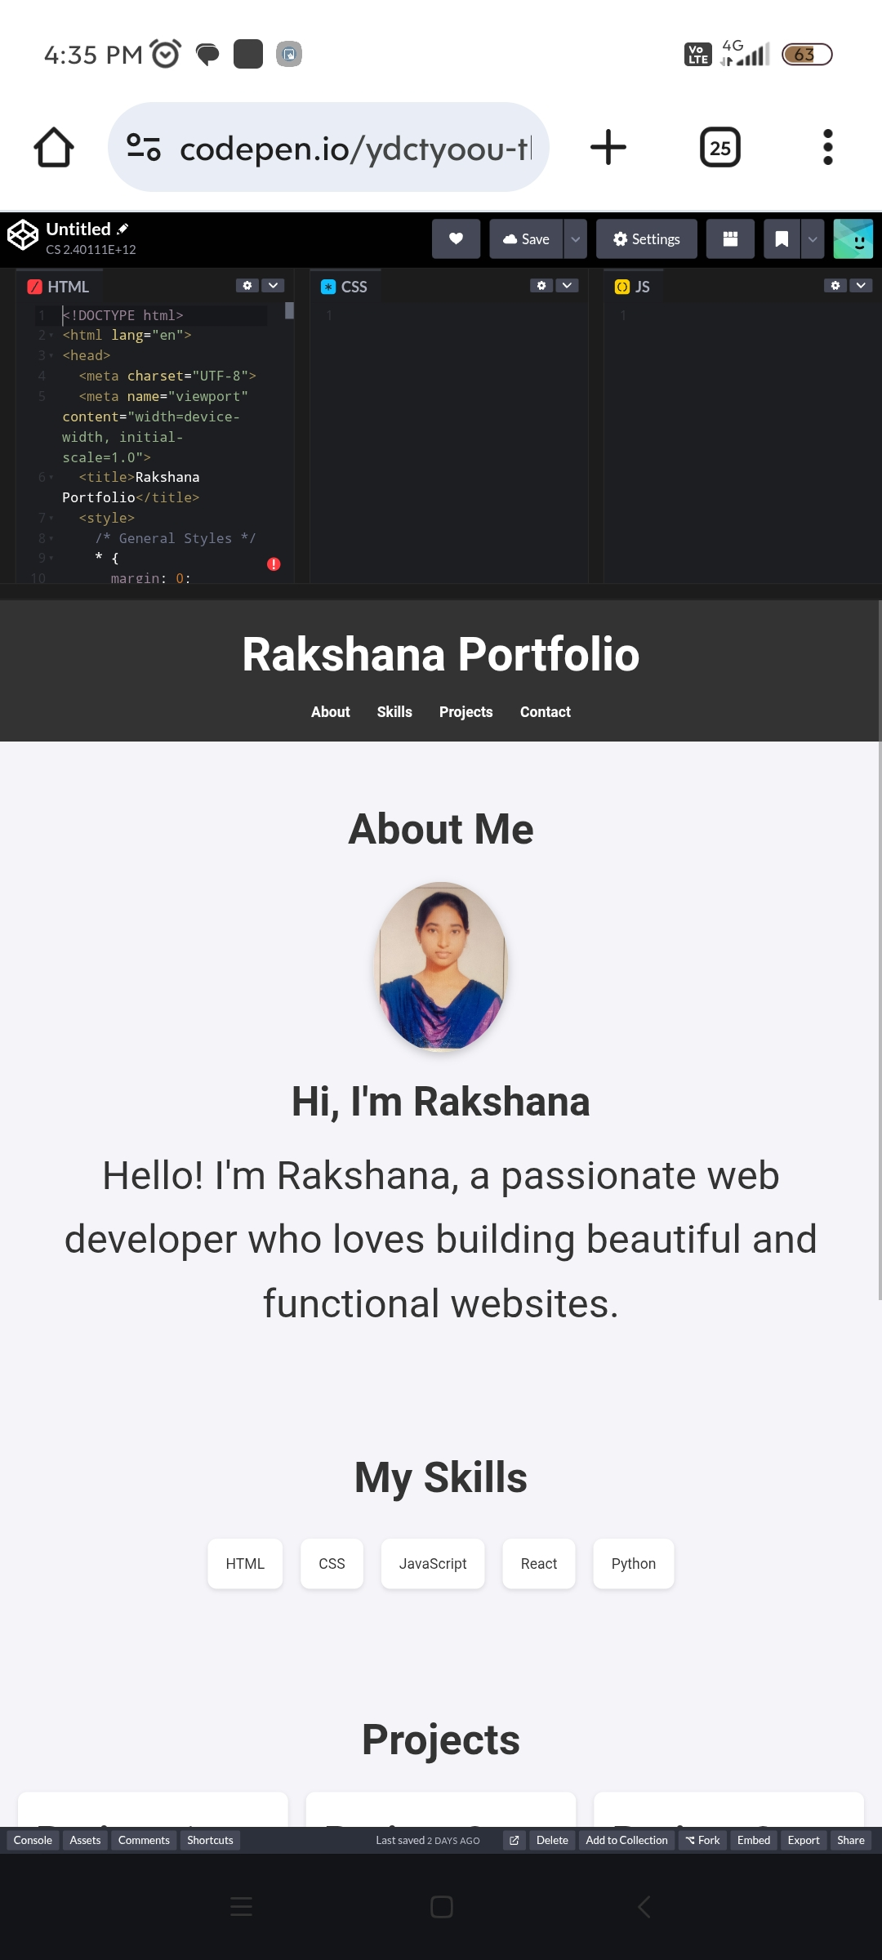
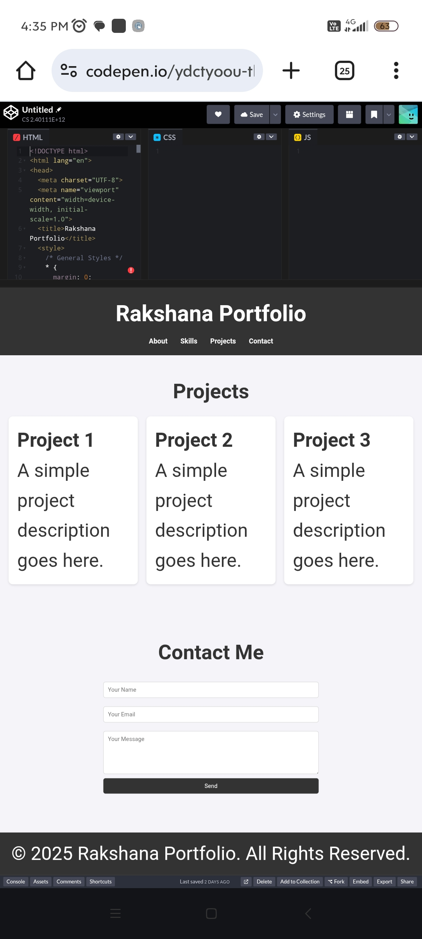

RESULTS AND SCREENSHOTS
3/21/2024 Annual Review
10
About Me page with personal info Skills section with progress bars Projects with GitHub links and live previews Contact form for emails Resume download option Responsive layout for all devices

Slide 11
CONCLUSION
Provides a professional way to present skills Bridges gap between resumes and practical work Easy to maintain and update Improves visibility to recruiters and mentors Interactive, modern, and user-friendly A valuable tool for students’ professional growth
11

